Slide 1
Association Between Healthy Lifestyle Behaviors and Cancer History
Jennifer Frediani, RD, PhD, ACSM-CES

Slide 2
Background
Fruit and vegetable intake and physical activity have an effect on the prevention of cancer.
The differences in these lifestyle behaviors has not been investigated between those with cancer and those with just a family history of cancer.
The Health Information National Trends Survey (HINTS) is a nationally represented survey conducted by the National Cancer Institute (NCI) to collect data about the American public’s use of cancer-related information.
HINTS 4 Cycle 2 includes all of the health behaviors plus information on cancer history and demographics

Slide 4
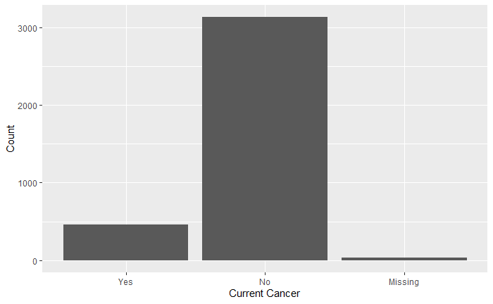
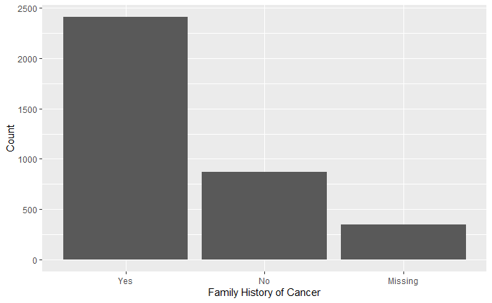

Slide 5
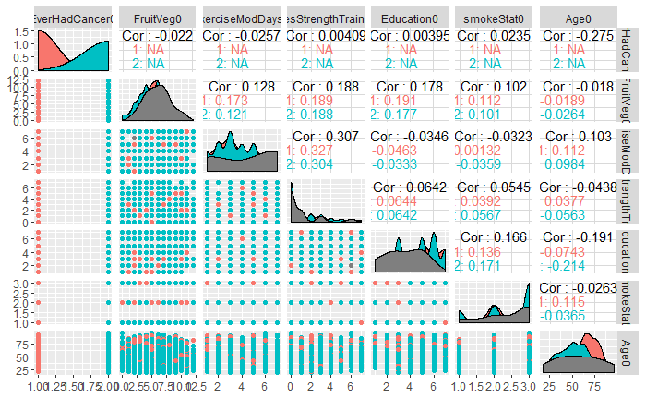

Slide 6
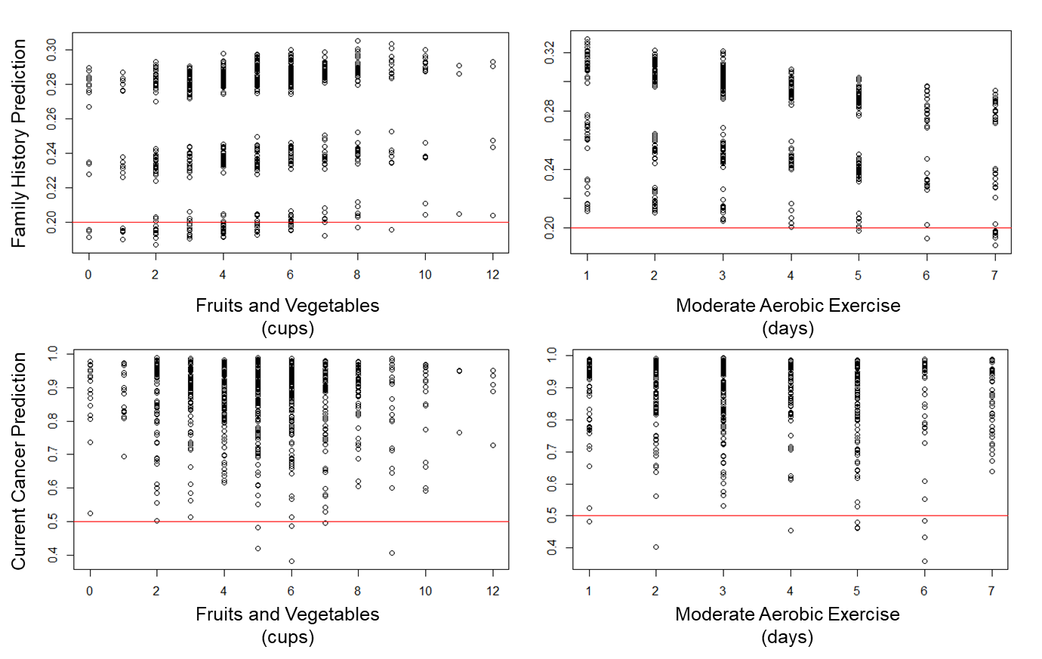

Slide 7
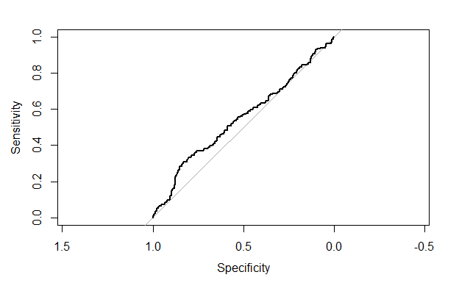
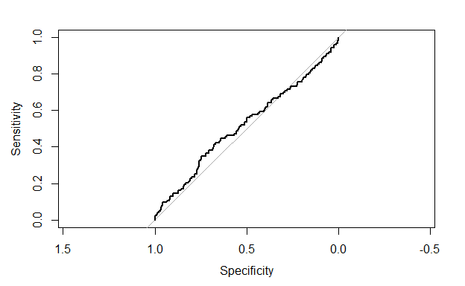
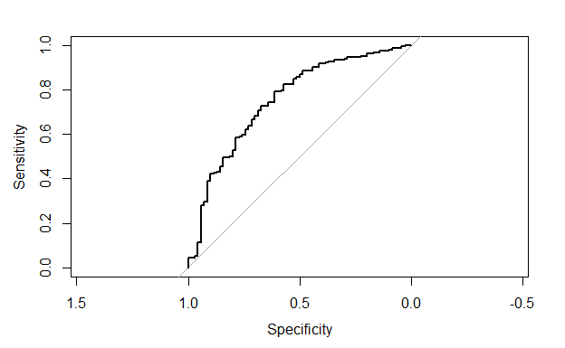
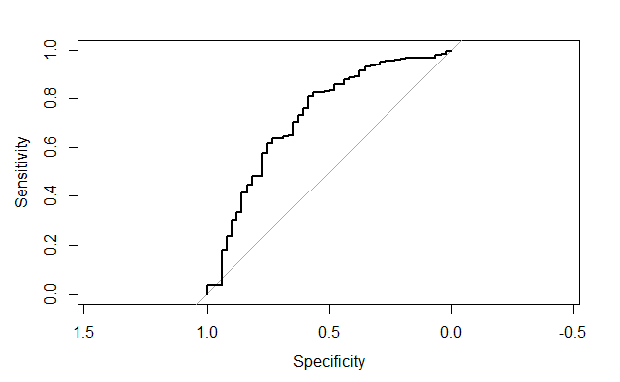
Family History of Cancer ~ Fruits and Vegetables
Family History of Cancer ~ Days of Aerobic Exercise
AUC – 0.55
AUC – 0.52
Current Cancer ~ Fruits and Vegetables
Current Cancer ~ Days of Aerobic Exercise
AUC – 0.75
AUC – 0.72

Slide 8
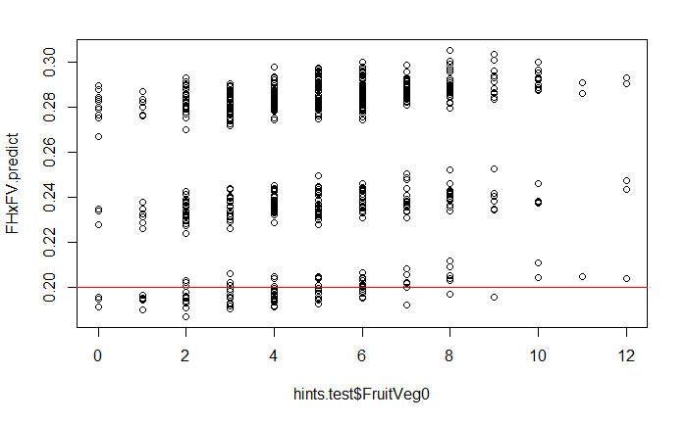
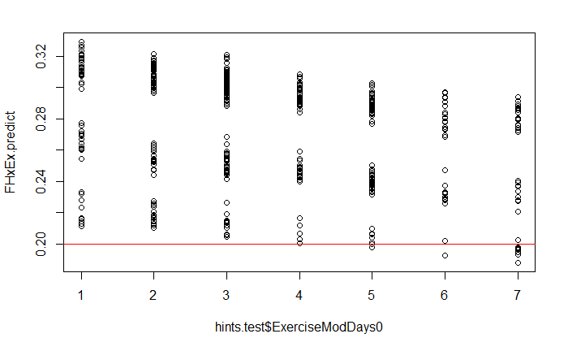
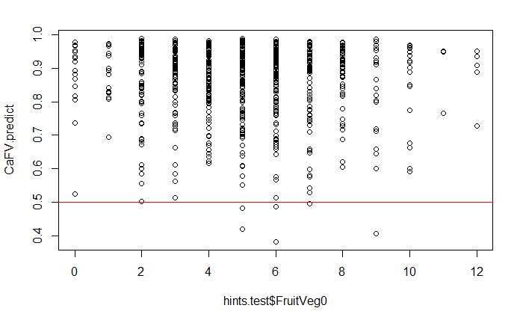
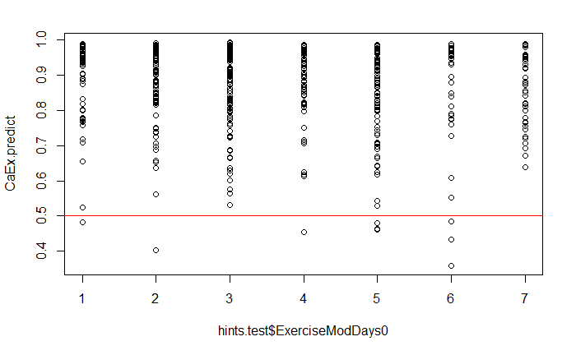
Family History Prediction
Fruits and Vegetables (cups)
Moderate Aerobic Exercise (days)
Current Cancer Prediction
Fruits and Vegetables (cups)
Moderate Aerobic Exercise (days)

